Slide 1
Data Visualization

Slide 2
Unit 3: Data Visualization
Visualization Design Principles,
Tables,
Univariate Data Visualization, Multivariate Data Visualization,
Visualizing Groups, Dynamic Techniques General Matplotlib Tips,
Two Interfaces for the Price of One,
Simple Line Plots,
Visualizing Errors, Density and Contour Plots, Histograms,
Binning, and Density, Customizing Plot Legends,
Customizing Color bars, Multiple Subplots, Text and Annotation, Customizing Matplotlib.

Slide 3
Visualization Design Principles,
Clarity: Avoid unnecessary elements
Accuracy: Represent data truthfully without distortion
Context: Provide necessary context, such as labels…
Efficiency: The viewer should be able to interpret the visualization quickly and easily
Aesthetics: Use a consistent style
Accessibility: Use color palettes

Slide 4
Data visualization
we can use Groupby & Aggregate functions with the matplotlib and seaborn functions to make beautiful graphic representations of our data.
Groupby Function
Groupby function is applied on a dataset and provides the set of grouped datasets based on column values. In simple terms, if any column has a set of values, then we want a smaller dataset where each smaller dataset contains each type of value based on that column.
Let’s say we have a dataset where we have a column named “Region,” and we want the set of datasets where each smaller datasets represent each region.

Slide 5
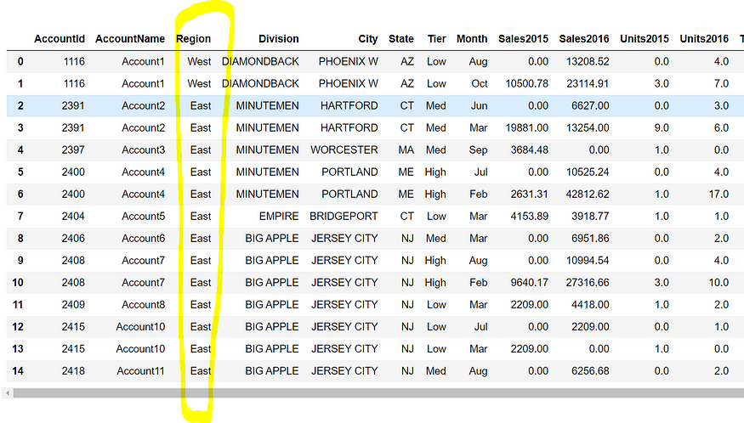

Slide 6
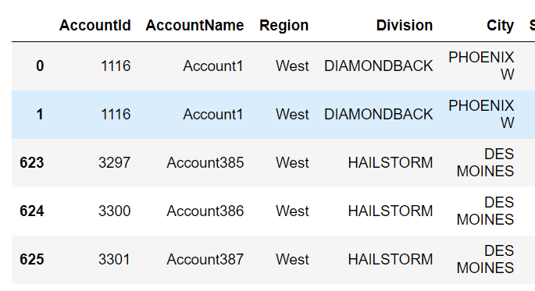
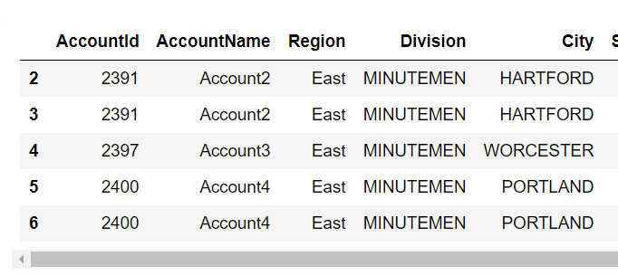
We can use the following code:
test=sales.groupby(by=["Region"])
Here, the main dataset name is sales that have a column named “Region.” We can utilize the get_group function to grab specific groups, as follows:
test.get_group("East")
test.get_group("West")

Slide 7
Univariate, Bivariate & Multivariate Analysis in Data Visualisation?
Data Visualisation is a graphical representation of information and data. By using different visual elements such as charts, graphs, and maps data visualization tools provide us with an accessible way to find and understand hidden trends and patterns in data.

Slide 8
Univariate Analysis
Univariate Analysis is a type of data visualization where we visualize only a single variable at a time. Univariate Analysis helps us to analyze the distribution of the variable present in the data so that we can perform further analysis.
1. Uivariate analysis on Numerical variables using the histogram function.
2. Univariate analysis of categorical data. We’ll be using the count plot function from the seaborn library

Slide 9
Bivariate analysis
Bivariate analysis is the simultaneous analysis of two variables. It explores the concept of the relationship between two variable whether there exists an association and the strength of this association or whether there are differences between two variables and the significance of these differences.
The main three types we will see here are:
Categorical v/s Numerical
Numerical V/s Numerical
Categorical V/s Categorical data

Slide 10
Multivariate Analysis
It is an extension of bivariate analysis which means it involves multiple variables at the same time to find correlation between them. Multivariate Analysis is a set of statistical model that examine patterns in multidimensional data by considering at once, several data variable.

Slide 11
Matplotlib
Matplotlib is a low level graph plotting library in python that serves as a visualization utility.
Matplotlib was created by John D. Hunter.
Matplotlib is open source and we can use it freely.
Matplotlib is mostly written in python, a few segments are written in C, Objective-C and Javascript for Platform compatibility.

Slide 12
Pyplot
Most of the Matplotlib utilities lies under the pyplot submodule, and are usually imported under the plt alias:
import matplotlib.pyplot as plt
Now the Pyplot package can be referred to as plt.

Slide 13
plot
matplotlib.pyplot.plot(*args, scalex=True, scaley=True, data=None, **kwargs)
Parameters
*args: These are the positional arguments that can be used to pass in the X and Y data points for plotting. Commonly, you pass X values first and then Y values (e.g., plot(x, y)), or you can pass just Y values (e.g., plot(y)) and X values are automatically assumed to be the indices of Y.
2. scalex, scaley: These are Boolean arguments (True by default). If scalex is True, the X-axis is automatically scaled to fit the data. If scaley is True, the Y-axis is automatically scaled to fit the data.
3. data: This can be a dictionary or a Pandas DataFrame. If provided, it allows referencing columns in the DataFrame by their names when plotting.
4.**kwargs: These are additional keyword arguments that allow customization of the plot. Examples include color, linewidth, marker, linestyle, etc.

Slide 14
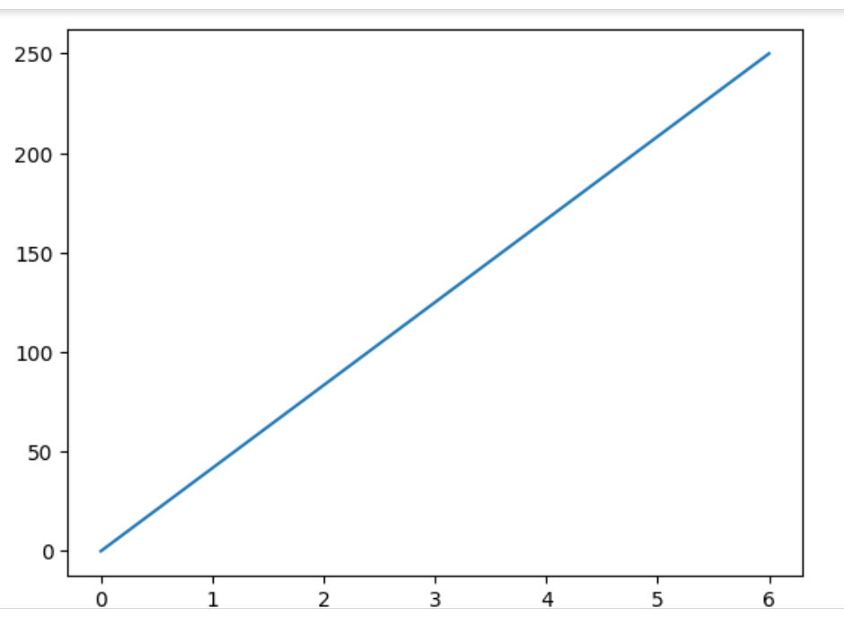
Draw a line in a diagram from position (0,0) to position (6,250):
The plot() function is used to draw points (markers) in a diagram.
By default, the plot() function draws a line from point to point.
The function takes parameters for specifying points in the diagram.
Parameter 1 is an array containing the points on the x-axis.
Parameter 2 is an array containing the points on the y-axis.
import matplotlib.pyplot as plt import numpy as np xpoints = np.array([0, 6]) ypoints = np.array([0, 250]) plt.plot(xpoints, ypoints) plt.show()

Slide 15
matplotlib.pyplot.xlabel()
Parameters:
matplotlib.pyplot.xlabel(xlabel, fontdict=None, labelpad=None, **kwargs)
xlabel: This parameter is the label text. And contains the string value.
labelpad: This parameter is used for spacing in points from the axes bounding box including ticks and tick labels and its default value is None.
**kwargs: This parameter is Text properties that is used to control the appearance of the labels.

Slide 16
Matplotlib.pyplot.ylabels() in Python
Parameters:matplotlib.pyplot.ylabel(ylabel, fontdict=None, labelpad=None, **kwargs)
ylabel: This parameter is the label text. And contains the string value.
labelpad: This parameter is used for spacing in points from the axes bounding box including ticks and tick labels and its default value is None.
**kwargs: This parameter is Text properties that is used to control the appearance of the labels.

Slide 17
Matplotlib.pyplot.title() Syntax in Python
matplotlib.pyplot.title(label, fontdict=None, loc=’center’, pad=None, **kwargs)
Parameters:
label(str): This argument refers to the actual title text string of the visualization depicted.
fontdict(dict) : This argument controls the appearance of the text such as text size, text alignment etc. using a dictionary. Below is the default fontdict:
fontdict = {‘fontsize’: rcParams[‘axes.titlesize’],
‘fontweight’ : rcParams[‘axes.titleweight’],
verticalalignment’: ‘baseline’,
‘horizontalalignment’: loc}
loc(str): This argument refers to the location of the title, takes string values like 'center', 'left' and 'right'.
pad(float): This argument refers to the offset of the title from the top of the axes, in points. Its default values in None.
**kwargs: This argument refers to the use of other keyword arguments as text properties such as color, fonstyle, linespacing, backgroundcolor, rotation etc.

Slide 18
matplotlib.pyplot.grid()
plt.grid(b=None, which='both', axis='both', color='k', linestyle='-', linewidth=0.8, alpha=None)
b (boolean, default: None): Determines whether to show or hide the grid.
which (str, default: 'both'): Specifies which grid lines to apply. Options are:'both' (default): Applies to both major and minor grid lines.'major’
axis (str, default: 'both'): Specifies which axis to apply the grid lines to.
color (str, default: 'k'): Sets the color of the grid lines. Default is 'k', which stands for black.
linestyle (str, default: '-'): Sets the style of the grid lines. Default is '-', which is a solid line.
.linewidth (float, default: 0.8): Sets the width of the grid lines. Default is 0.8.
alpha (float, default: None): Sets the transparency level of the grid lines.

Slide 19
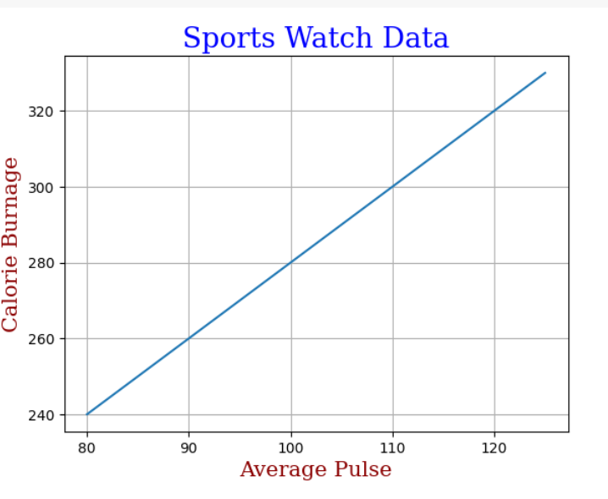
Matplotlib Labels and Title
you can use the xlabel() and ylabel() functions to set a label for the x- and y-axis.
you can use the title() function to set a title for the plot.
you can use the grid() function to add grid lines to the plot.

Slide 20
matplotlib.pyplot.axis()
This function is used to set some axis properties to the graph.
Syntax: matplotlib.pyplot.axis(*args, emit=True, **kwargs)
Parameters
*args: Positional arguments that can be used in various ways:If no arguments are provided, axis() returns the current axis limits as [xmin, xmax, ymin, ymax].If a list or tuple of four values is provided (e.g., [xmin, xmax, ymin, ymax]), it sets the axis limits.If a string is provided, it can control the axis scaling or appearance with specific keywords (explained below).
emit: A Boolean (default is True). When True, it triggers an axes event, which can be used by interactive backends to update the plot. Generally, you don't need to worry about this unless you're doing advanced event handling.
**kwargs: Additional keyword arguments that are less commonly used directly with axis() but can include properties like label, units, etc.

Slide 21
Setting the Axis Limits:plt.axis([xmin, xmax, ymin, ymax]): This sets the limits of the x-axis and y-axis to the specified values.Getting the Current Axis Limits:plt.axis() without arguments returns the current axis limits as [xmin, xmax, ymin, ymax].
Other Options:plt.axis('equal'): Sets the aspect ratio so that the data units are the same in every direction.
plt.axis('tight'): Sets the axis limits to fit the data tightly.
plt.axis('off'): Turns off the axis lines and labels.

Slide 22
subplot() Function subplot(nrows, ncols, index, **kwargs) subplot(pos, **kwargs) subplot(ax) Parameters :
args: Either a 3-digit integer or three separate integers describing the position of the subplot.
pos is a three-digit integer where the first, second, and third integer are nrows,ncols, index.
projection : [{None, ’aitoﬀ’, ’hammer’, ’lambert’, ’mollweide’, ’polar’, ’rectilinear’, str}, optional]. The projection-type of the subplot (Axes). The default None results in a ’rectilinear’ projection.
label : [str] A label for the returned axes.
**kwargs: This method also takes the keyword arguments for the returned axes base class;
except for the ﬁgure argument, for e.g facecolor.

Slide 23
subplot() Function
The subplot() function takes three arguments that describes the layout of the figure.
The layout is organized in rows and columns, which are represented by the first and second argument.
The third argument represents the index of the current plot.

Slide 24
Creating Scatter Plots
A scatter plot is a type of data visualization that displays values for two variables as points on a Cartesian plane. It is useful for showing the relationship between two numerical variables and identifying patterns, correlations, or clusters.

Slide 25
Syntax: matplotlib.pyplot.scatter(x_axis_data, y_axis_data, s=None, c=None, marker=None, cmap=None, vmin=None, vmax=None, alpha=None, linewidths=None, edgecolors=None)
Parameters:
x_axis_data: An array containing data for the x-axis.matplotlib
s: Marker size, which can be a scalar or an array of size equal to the size of x or y.
c: Color of the sequence of colors for markers.
marker: Marker style.
cmap: Colormap name.
linewidths: Width of the marker border.
edgecolor: Marker border color.
alpha: Blending value, ranging between 0 (transparent) and 1 (opaque)

Slide 26
Legend()
syntax: legend(*args, **kwargs)
This can be called as follows,
legend() -> automatically detects which element to show. It does this by displaying all plots that have been labeled with the label keyword argument.
legend(labels) -> Name of X and name of Y that is displayed on the legend
legend(handles, labels) -> A list of lines that should be added to the legend. Using handles and labels together can give full control of what should be displayed in the legend. The length of the legend and handles should be the same.

Slide 27
Bars Plot
A bar plot is a graphical representation of data where rectangular bars or columns are used to represent different categories. The height of each bar corresponds to the value it represents.
The horizontal axis (x-axis) typically represents the categories or groups being compared, while the vertical axis (y-axis) represents the values or quantities associated with each category. Each bar starts at the axis and extends horizontally or vertically, depending on the orientation of the graph.

Slide 28
plt.bar(x, height, width=0.8, align='center', color=None, label=None)
x is the positions of the bars on the x-axis.
height is the heights of the bars.
width (optional) is the width of the bars. Default is 0.8.
align (optional) is alignment of the bars. Default is 'center'.
color (optional) is the color of the bars. Default is None, which results in the default color.
label (optional is a label for the legend.

Slide 29
Matplotlib.pyplot.barh() function in Python
Creating a Horizontal bar plot
Syntax: matplotlib.pyplot.barh(y, width, height=0.8, left=None, *, align=’center’, **kwargs)

Slide 30
Pie Chart
A Pie Chart is a circular statistical plot that can display only one series of data. The area of the chart is the total percentage of the given data. Pie charts are commonly used in business presentations like sales, operations, survey results, resources, etc. as they provide a quick summary. In this article, let’s understand how to create pie chart in python with pie diagram.

Slide 31
Syntax: matplotlib.pyplot.pie(data, explode=None, labels=None, colors=None, autopct=None, shadow=False) Parameters: data represents the array of data values to be plotted, the fractional area of each slice is represented by data/sum(data). If sum(data)<1, then the data values returns the fractional area directly, thus resulting pie will have empty wedge of size 1-sum(data). labels is a list of sequence of strings which sets the label of each wedge. color attribute is used to provide color to the wedges. autopct is a string used to label the wedge with their numerical value. shadow is used to create shadow of wedge.

Slide 32
Histogram
A histogram is used to represent data provided in the form of some groups. It is an accurate method for the graphical representation of numerical data distribution. It is a type of bar plot where the X-axis represents the bin ranges while the Y-axis gives information about frequency

Slide 33
Syntax: matplotlib.pyplot.hist(x, bins=None, range=None, density=False, weights=None, cumulative=False, bottom=None, histtype=’bar’, align=’mid’, orientation=’vertical’, rwidth=None, log=False, color=None, label=None, stacked=False, \*, data=None, \*\*kwargs)
Parameters: This method accept the following parameters that are described below:
x : This parameter are the sequence of data.
bins : This parameter is an optional parameter and it contains the integer or sequence or string.
range : This parameter is an optional parameter and it the lower and upper range of the bins.
density : This parameter is an optional parameter and it contains the boolean values.
weights : This parameter is an optional parameter and it is an array of weights, of the same shape as x.
bottom : This parameter is the location of the bottom baseline of each bin.
histtype : This parameter is an optional parameter and it is used to draw type of histogram. {‘bar’, ‘barstacked’, ‘step’, ‘stepfilled’}
align : This parameter is an optional parameter and it controls how the histogram is plotted. {‘left’, ‘mid’, ‘right’}
rwidth : This parameter is an optional parameter and it is a relative width of the bars as a fraction of the bin width
log : This parameter is an optional parameter and it is used to set histogram axis to a log scale
color : This parameter is an optional parameter and it is a color spec or sequence of color specs, one per dataset.
label : This parameter is an optional parameter and it is a string, or sequence of strings to match multiple datasets.
normed : This parameter is an optional parameter and it contains the boolean values.It uses the density keyword argument instead.
Returns: This returns the following
n :This returns the values of the histogram bins.
bins :This returns the edges of the bins.
patches :This returns the list of individual patches used to create the histogram.

Slide 34
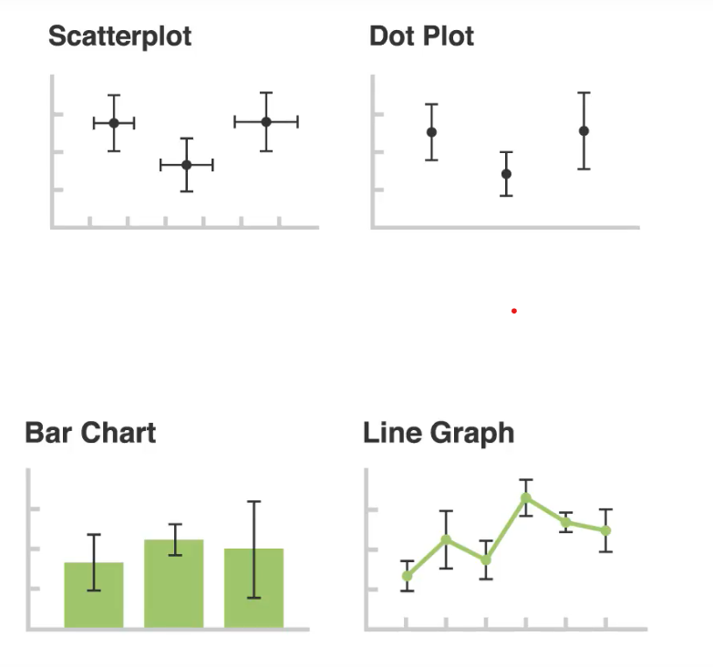
Visualizing Error
Visualizing errors in data is an essential aspect of data analysis, especially when evaluating the performance of models or when working with experimental data. Matplotlib provides various ways to visualize errors, including error bars, confidence intervals, and shaded regions.

Slide 35
matplotlib.pyplot.errorbar(x, y, yerr=None, xerr=None, fmt=”, ecolor=None, elinewidth=None, capsize=None, barsabove=False, lolims=False, uplims=False, xlolims=False, xuplims=False, errorevery=1, capthick=None, \*, data=None, \*\*kwargs)
Parameters: This method accept the following parameters that are described below:
x, y: These parameter are the horizontal and vertical coordinates of the data points.
fmt: This parameter is an optional parameter and it contains the string value.
xerr, yerr: These parameter contains an array.And the error array should have positive values.
ecolor: This parameter is an optional parameter. And it is the color of the errorbar lines with default value NONE.
elinewidth: This parameter is also an optional parameter. And it is the linewidth of the errorbar lines with default value NONE.
capsize: This parameter is also an optional parameter. And it is the length of the error bar caps in points with default value NONE.
barsabove: This parameter is also an optional parameter. It contains boolean value True for plotting errorsbars above the plot symbols.Its default value is False.
lolims, uplims, xlolims, xuplims: These parameter are also an optional parameter. They contain boolean values which is used to indicate that a value gives only upper/lower limits.
errorevery: This parameter is also an optional parameter. They contain integer values which is used to draws error bars on a subset of the data.
Returns: This returns the container and it is comprises of the following:
plotline:This returns the Line2D instance of x, y plot markers and/or line.
caplines:This returns the tuple of Line2D instances of the error bar caps.
barlinecols:This returns the tuple of LineCollection with the horizontal and vertical error ranges.

